Slide 1
Demo 2: single cell analysis
Ashlyn Anderson
PhD Candidate, Cochran lab
5/28/26

Slide 2
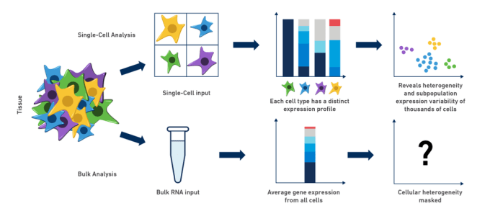
Single cell vs “bulk” approaches

Slide 3
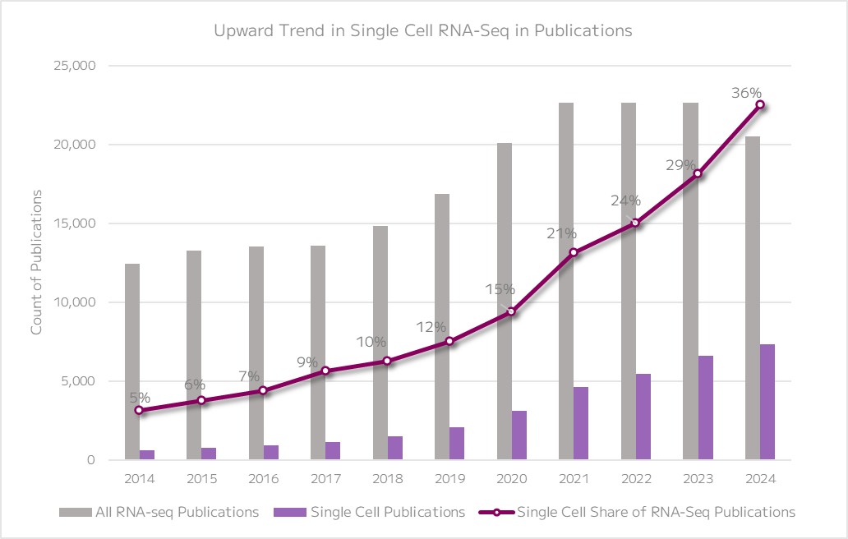
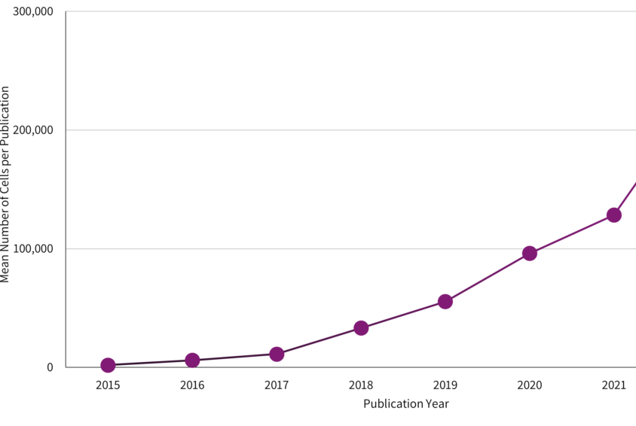
Single cell is everywhere

Slide 4
Using single cell approaches to decipher Alzheimer’s genetics

Slide 5
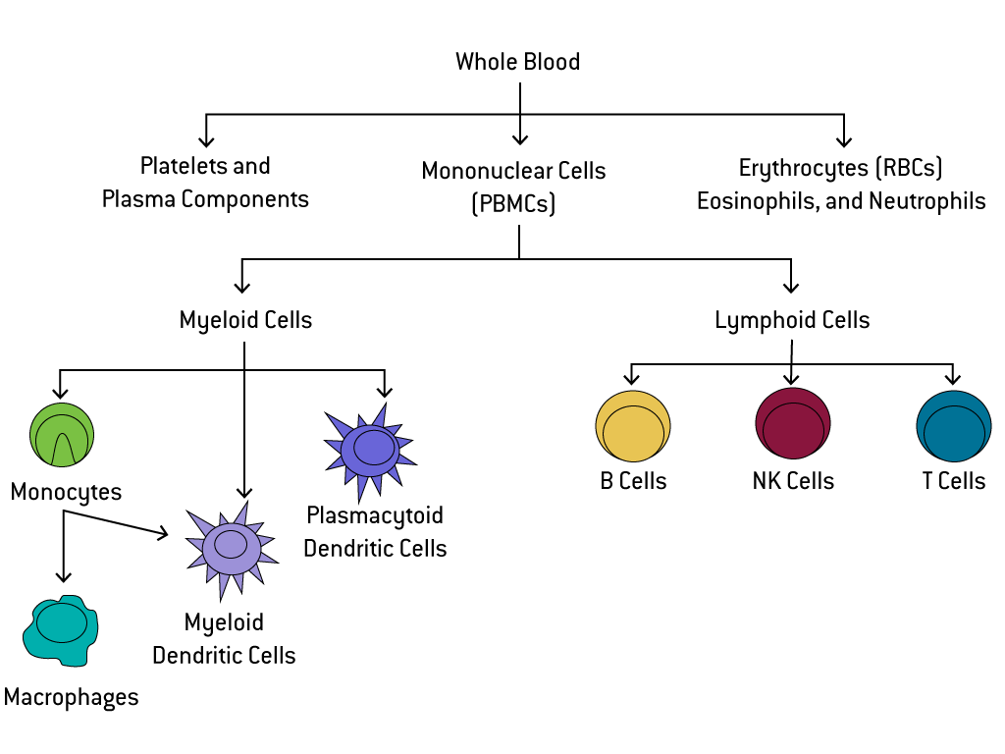
Today’s data: PBMC

